Slide 1


CDAT Overview and Updates
Eric Green

Slide 2
Tool Overview
Crash Data Access Analysis Tool CDAT
Web app
CDAT integrates crash and roadway data and then users can query a segment or intersection to obtain a safety score as compared to other segments or intersections employing techniques from the Highway Safety Manual.
Who has used CDAT?

Slide 3
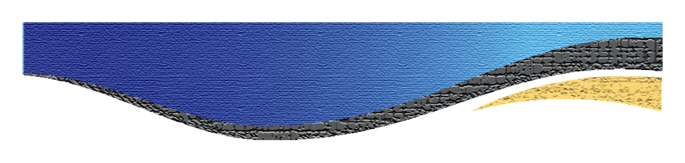
Key Features
Mapping interface can be used to query and to display crashes and roadway data.
Charts and graphs provide a better understanding of the crash types and can be compared to other, similar roads.
Pre-loaded with current state-based Safety Performance Functions (SPFs) for a variety of crash types and severities.
Users can use CDAT to prioritize projects or evaluate highway improvements.
Helps promote the importance of roadway homogeneity.

Slide 4
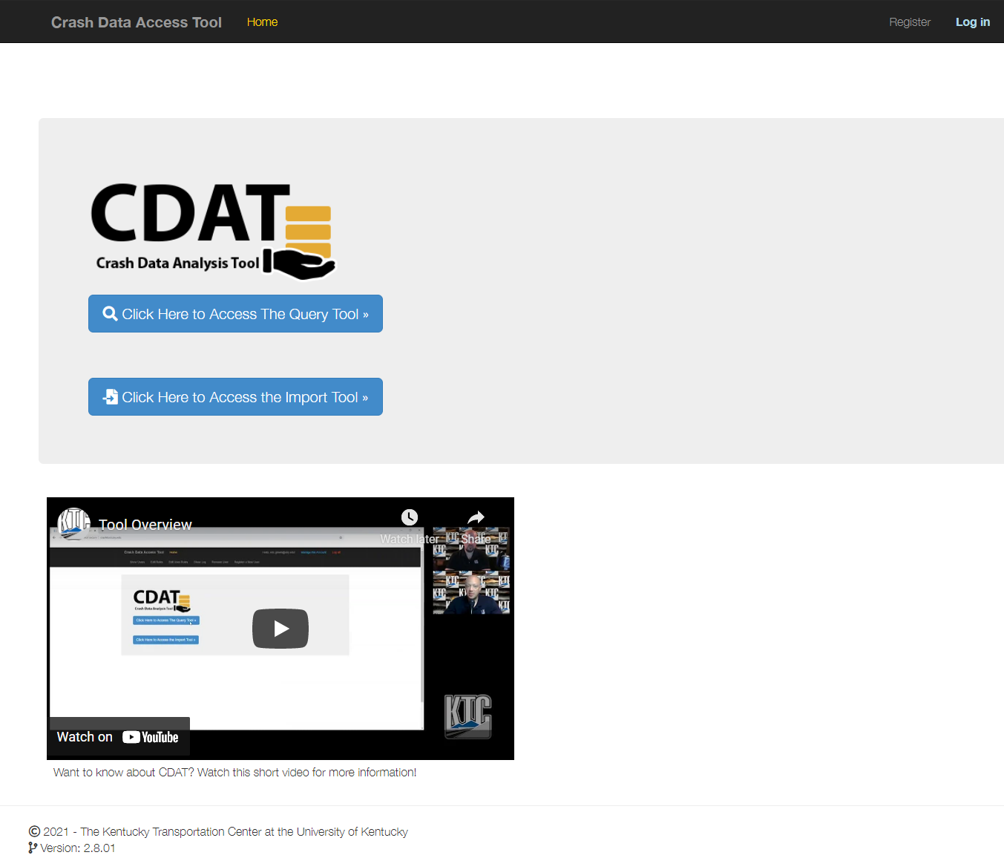

http://crashtool.uky.edu

Slide 5
Functionality
Query mode:
  Country, route and milepoint range
Import mode:
  Upload your own file

Slide 6
CDAT Query Walkthrough
Enter County, Route, and MP range
View basic roadway data tabularly
View/interact with map
Choose severity, filters, road type, time frame
View advanced roadway data
View intersections crashes types along segment
View intersections in detail
View crash map
View segment crash types

Slide 7
CDAT Query Walkthrough
Maps are interactive
  Layers can be toggled
Segmentation Score
SPF Matching
EEC
Standard Deviation
LOSS
All tables can be exported
Narratives
Open map to crash

Slide 8
CDAT Improvements
-September 2025

Slide 9
Updates Recently Completed
fix dark mode
Be able to change the 5-year period for SPF calculations
Inclusion of speed data - speed SPFs and add speed to map
Fix show log on admin
Maintain page position on user role
fix maintain page position
disable scroll on maps
Be able to toggle crashes on and off of map
Show the milepoints on the map
UI/UX color
Change the background and text colors. Consider color blind and contrast.
Add narratives for Excel download
Make the intersection table downloadable
Moved to new server
Added 2014-2025!

Slide 10
New Years Added
2014 and 2015 do not have narratives
Always using current HIS

Slide 11
Upcoming…
PDF summary
Export each intersection as an individual summary
Make auto segments more obvious - straight line diagrams
Buttons to allow users to create segments based on HIS elements
Include Google maps overlay on the maps
Include a sensitivity analysis by modifying segment length slightly
Provide suggestions on minimum and maximum segment lengths
Make the tool more helpful to use for ICE analysis
Filters based on the use case; changes query types based on user needs (ICE, HSIP, pavement rehab)
Symbology change for manner of collision or severity
Link the research reports where the SPFs were created
Add links to metadata for HIS

Slide 12
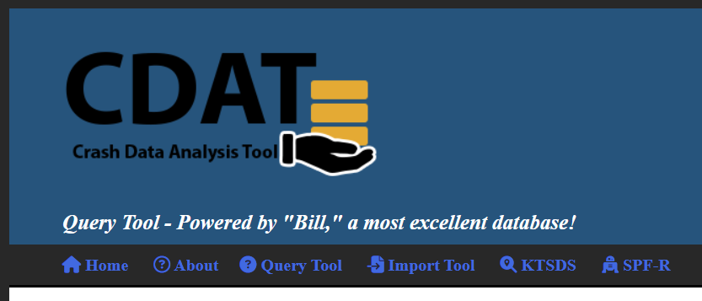
New Look and Feel

Slide 13
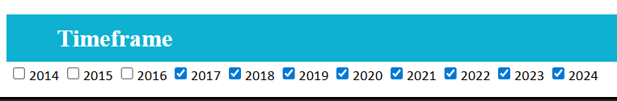
Years and Years!

Slide 14
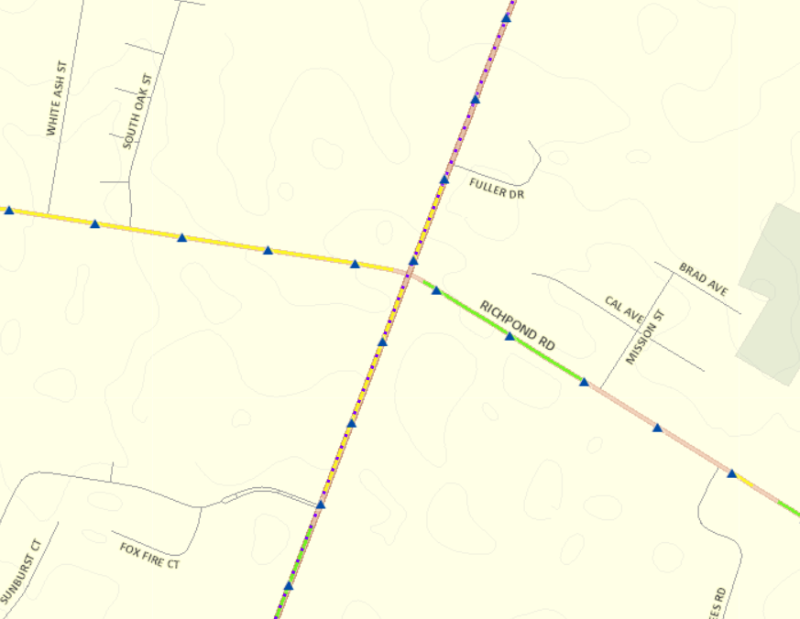

Slide 15
Importance of Homogeneity
US 60 in Fayette County
2020-2024 Data
Roadway geometry varies
Matching SPF unclear
Misleading EEC?

Slide 16
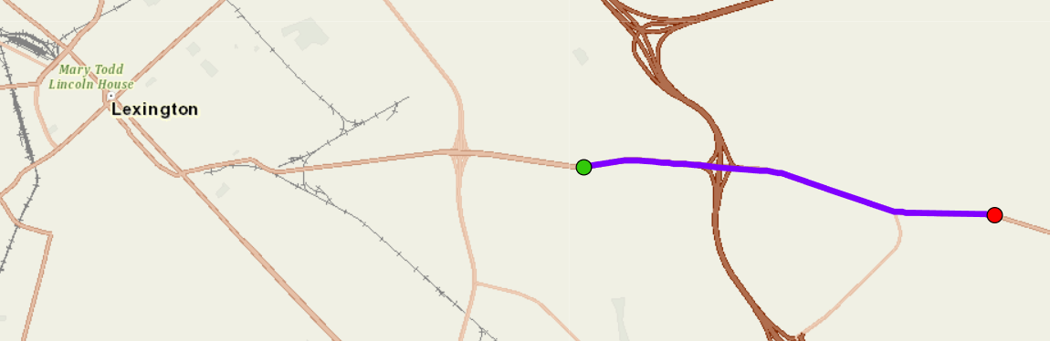
Fayette County US 60 – MP 11 to 14

Slide 17
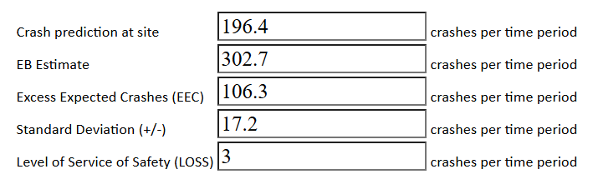

Slide 18
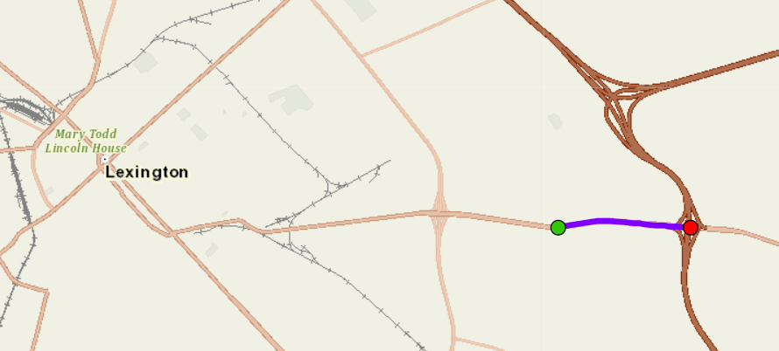
Fayette County US 60 – MP 11 to 12

Slide 19
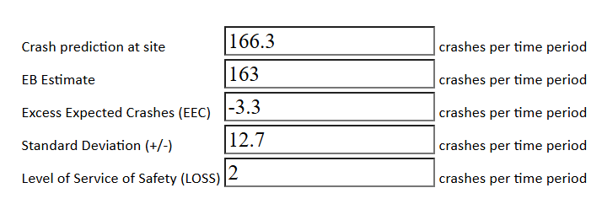

Slide 20
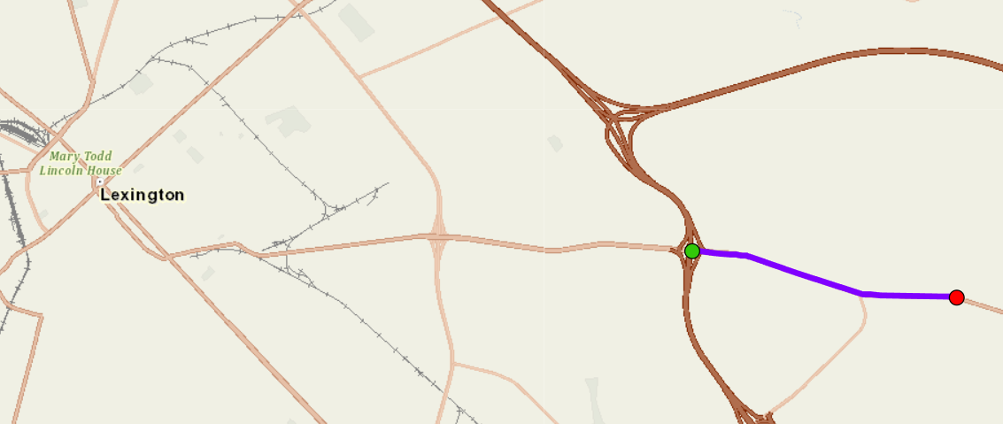
Fayette County US 60 – MP 12 to 14

Slide 21
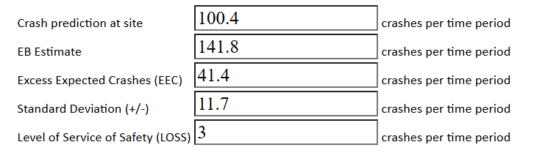

Slide 22
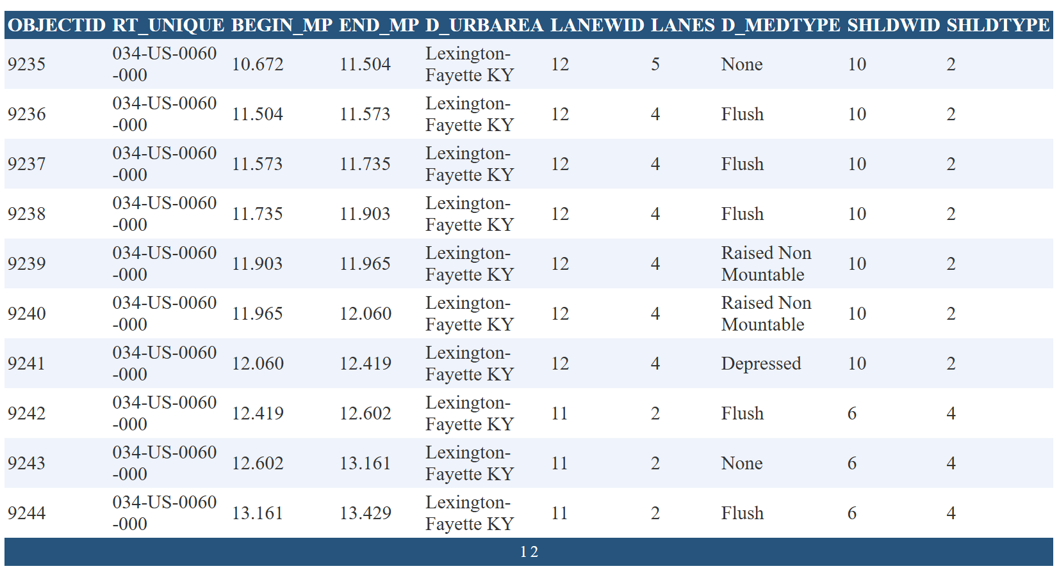

Slide 23
Open Discussion

Slide 24
Live Demo
http://crashtool.uky.edu/

Slide 25
THANK YOU

